Slide 1
Rearranging Mechanical Advantage Equation and teach examples

Slide 2
Learning Objectives
I can mathematically rearrange the mechanical advantage equation.
I can calculate mechanical advantage using the formula.
Notes:
In this lesson, students will learn the definitions of both potential and kinetic energy. They will also be able to give examples of each and explain how potential energy changes into kinetic energy.

Slide 3
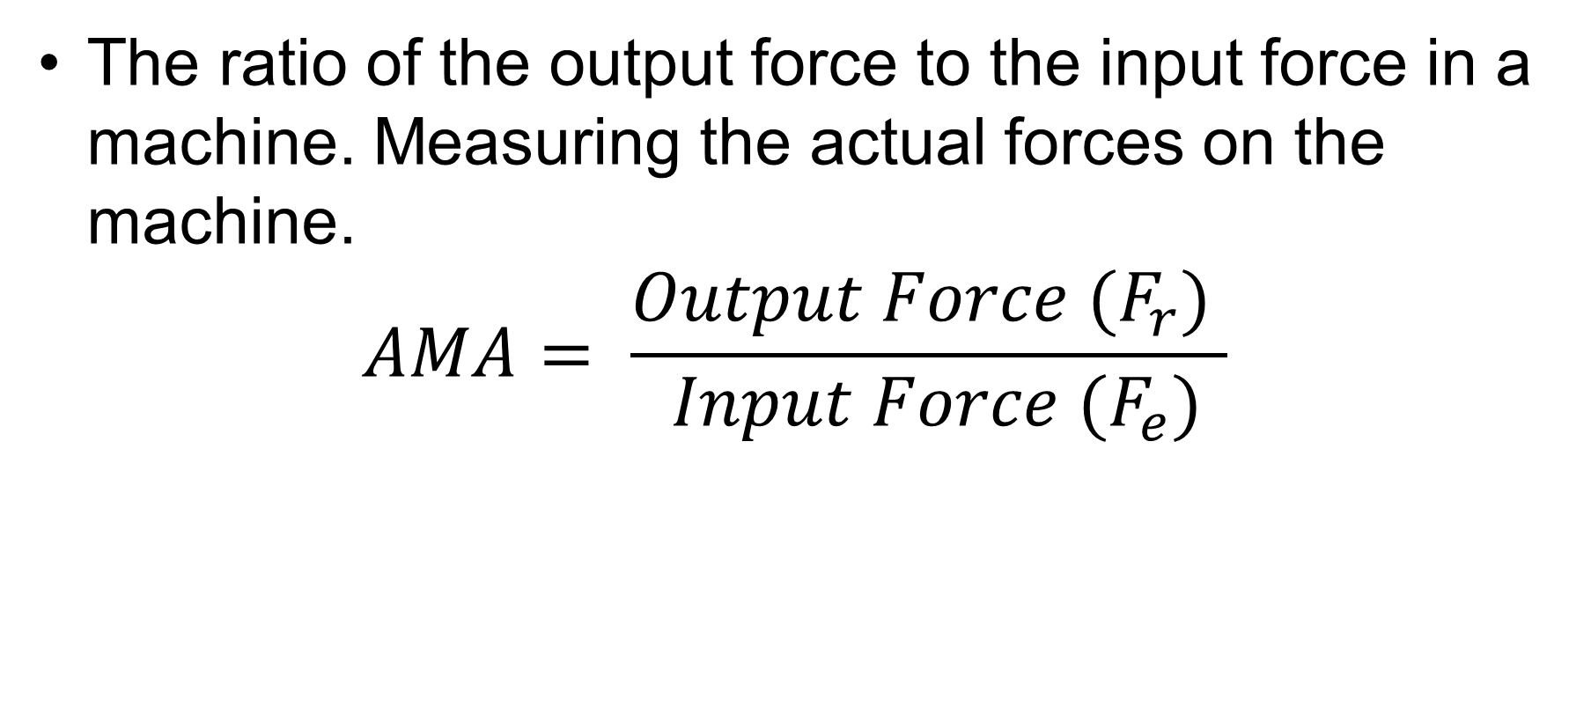
Actual Mechanical Advantage (AMA)
The ratio of the output force to the input force in a machine. Measuring the actual forces on the machine.
$$AMA= \frac{{Output Force (F}_{r}) }{ {Input Force (F}_{e})}$$
The higher the Mechanical Advantage, the easier it is to move something.
We want to make the MA number bigger!!!
Means more Output force from the machine,
less Input force from you! = less effort!!!
Basic M.A.= 1

Slide 4
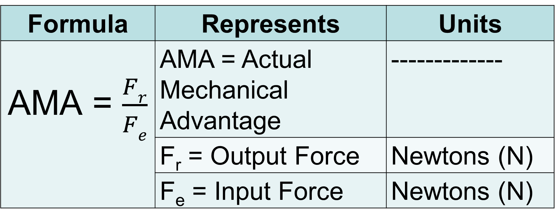
Formula Representation
Formula | Represents | Units
AMA = $\frac{Fr}{Fe}$ | AMA = Actual Mechanical Advantage | -------------
 | F_{r} = Output Force | Newtons (N)
 | F_{e} = Input Force | Newtons (N)

Slide 5
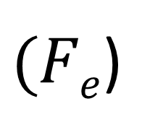
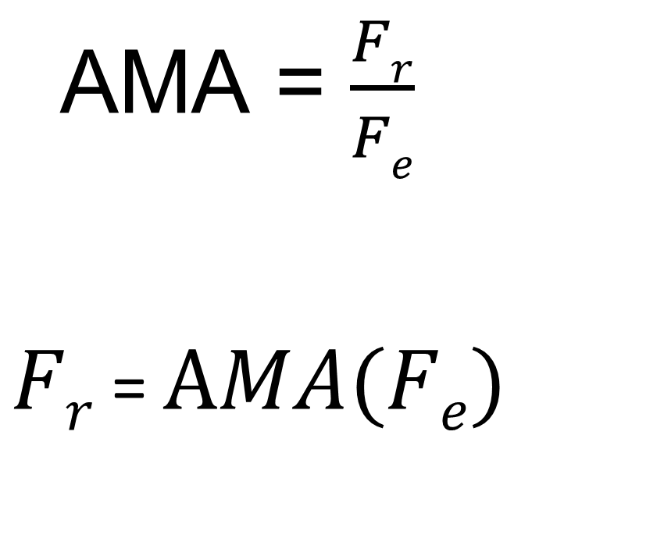
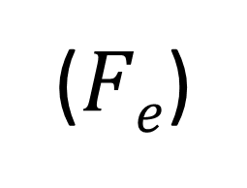
Solve for Output/Resistance Force (F_{r})
$(Fe$)
Step 1 – Multiply both sides by input force F_{e}
AMA = $\frac{Fr}{Fe}$
$Fr$ = $AMA(Fe)$
($Fe$)

Slide 6
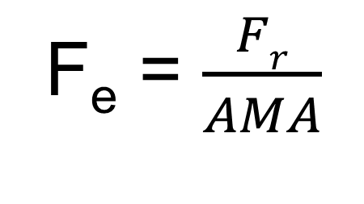

Solve for Input Force/Effort Force (F_{e})
AMA = $\frac{Fr}{Fe}$
Step 1 – Multiply both sides by input force F_{e}
Step 2 – Divide by AMA – actual mechanical advantage on both sides.
(F_{e})
(F_{e})
F_{r} = (F_{e})AMA
__
AMA
__
AMA
F_{e} = $\frac{Fr}{AMA}$

Slide 7
AMA Related Equations
IMA | Input Force | Output Force
AMA = $\frac{F_{r}}{F_{e}}$ | F_{e} = $\frac{F_{r}}{AMA}$ | F_{r} = (AMA)F_{e}
Represents | Common Units (SI)
AMA = Actual Mechanical Advantage | ----------------------
F_{r} = Output force/resistance force | Newtons
F_{e} = Input force/effort force | Newtons

Slide 8

Calculation Example #1
1. A lever lifts 280N with an effort of 40N. What is the mechanical advantage?
Given/ Unknown | Work
AMA = F_{e} = F_{r} =
?
40N
$$AMA=\frac{F_{r}}{F_{e}}$$
$$AMA= \frac{280N}{40N}$$
$$AMA=7$$
280N

Slide 9

Calculation Example #2
2. How much effort is needed to lift a 200N object with a lever that has a mechanical advantage of 4?
Given/ Unknown | Work
AMA = F_{e} = F_{r} =
4
?
$$F_{e}=\frac{F_{r}}{AMA}$$
$$F_{e}= \frac{200N}{4}$$
$$F_{e}=50N$$
200N

Slide 10
Calculation Example #3
3. A moving pulley has a mechanical advantage of 2 and you use 200N of force. What is the force/weight of the object?
Given/ Unknown | Work
AMA = F_{e} = F_{r} =
2
200N
$$\text{F}\text{r}\text{ = }\text{AMA}\text{(}\text{Fe}\text{)}$$
$$\text{F}\text{r}\text{ = (2)(200}\text{N}\text{)}$$
$$\text{F}\text{r}\text{ = 400}\text{N}$$
?

